Slide 1
Road to Happiness with Data Science
Python For Data Science (CSIT 552) Final Project
Vinayak Vemula
April 2025
Group Project

Slide 2
Introduction
This project analyzes daily activity logs submitted by students to understand what makes people happy. Using the provided time-use and happiness data, we cleaned and organized entries across different days and individuals.
The goal is to uncover patterns and routines shared among students that influence happiness.
By transforming raw time data into structured insights, we use data science to explore human behavior.

Slide 3
Objective
To discover how lifestyle choices like sleep, activity types, and screen time affect happiness.
To evaluate hypotheses about morning routines, sleep duration, and electronics usage.
To use visualizations and summary statistics to validate behavioral trends.
Ultimately, to identify habits that contribute to higher happiness among students.

Slide 4
Data Cleaning
Processed multiple Excel sheets containing raw student logs.
Standardized activity labels (e.g., "Netflix time" → "watching drama").
Removed incomplete, duplicated, or invalid entries.
Converted time and happiness fields into clean, usable formats.

Slide 5
Hypothesis 1: Sleep vs Happiness
We extracted and summed sleep hours per day for each student.
Visualization showed a positive trend between sleep and mood.
Observation: More sleep generally led to higher happiness scores.

Slide 6
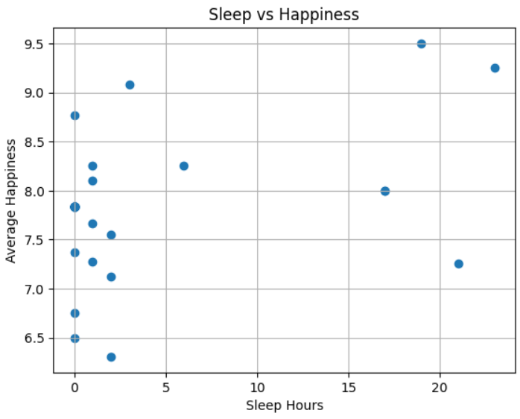
Sleep vs Happiness
Scatter plot
Scatter plot

Slide 7
Hypothesis 2: Morning vs Night People
We classified activity times into morning vs night groups.
Box plots showed morning activities had slightly higher happiness ratings.
Finding: Morning people reported slightly higher happiness.

Slide 8
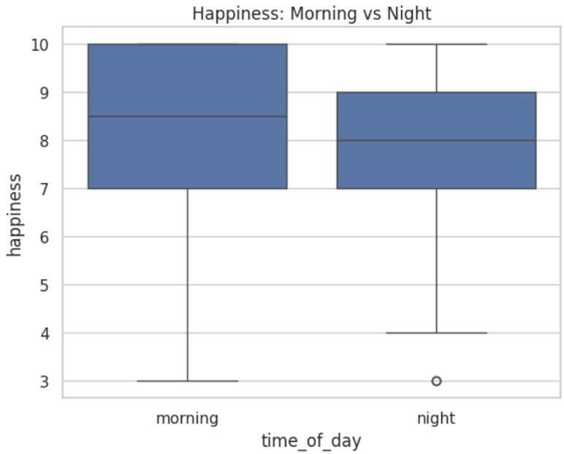
Morning vs
Night People

Slide 9
Hypothesis 3: Electronics vs Non-Electronics
Hypothesis: Using phones and screens reduces happiness.
Activities involving “phone”, “tablet”, or “Netflix” were flagged.
Comparison showed lower happiness scores during electronic use.
Insight: Excessive screen time may decrease mood.

Slide 10
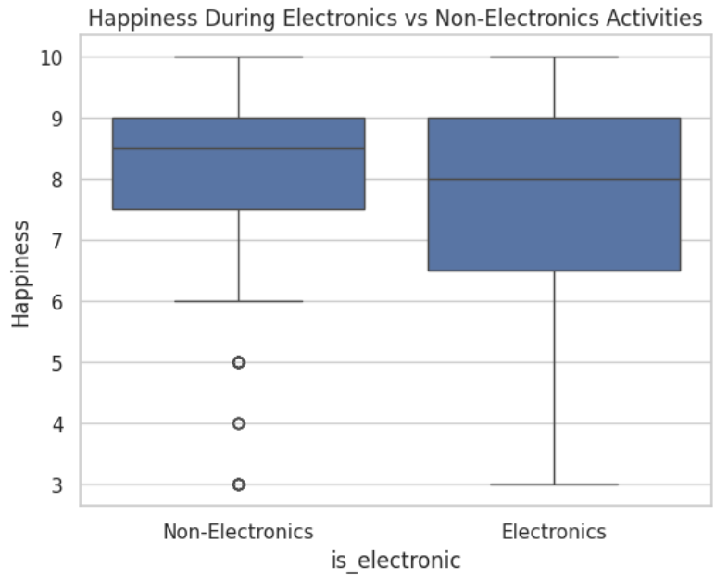
Electronics vs
Non-Electronics

Slide 11
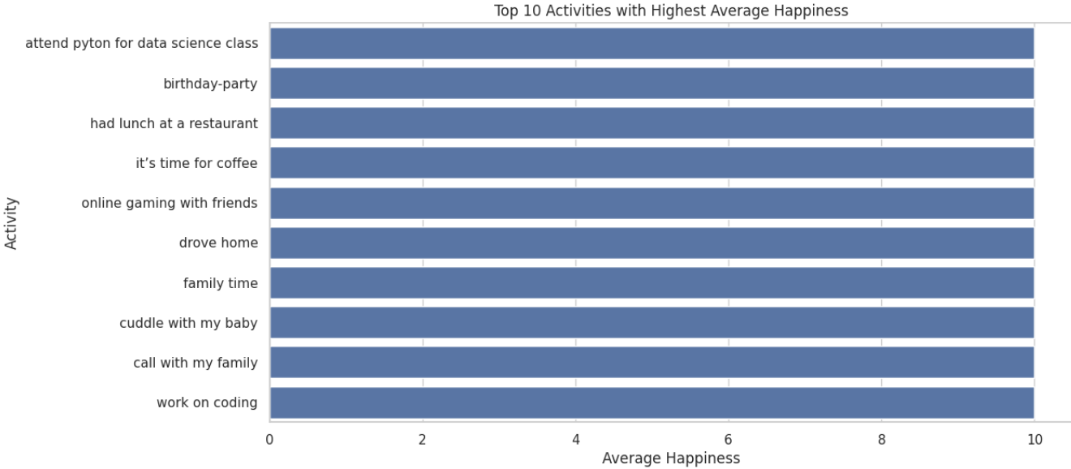
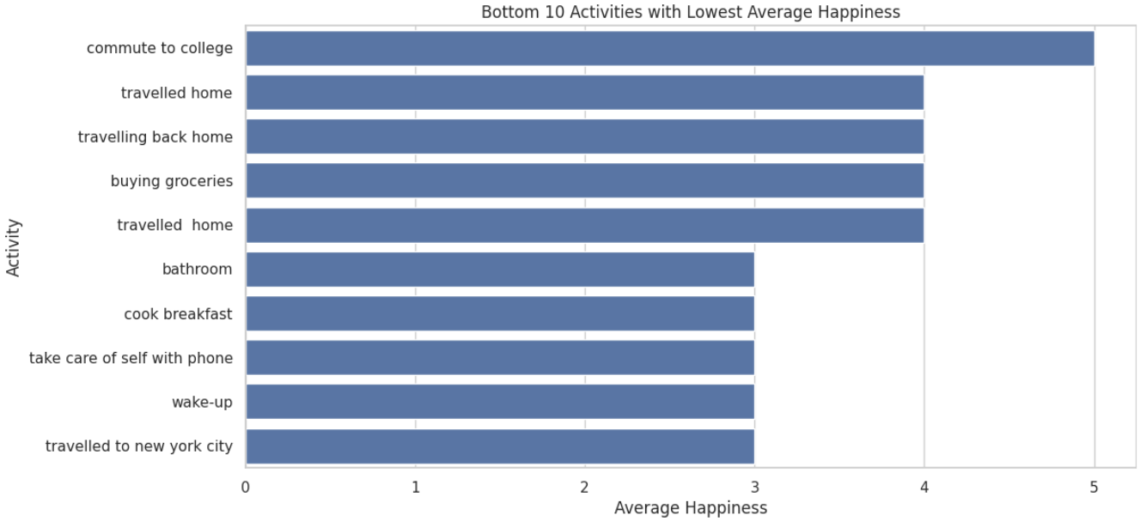
Highest And Lowest Happiness Activities

Slide 12
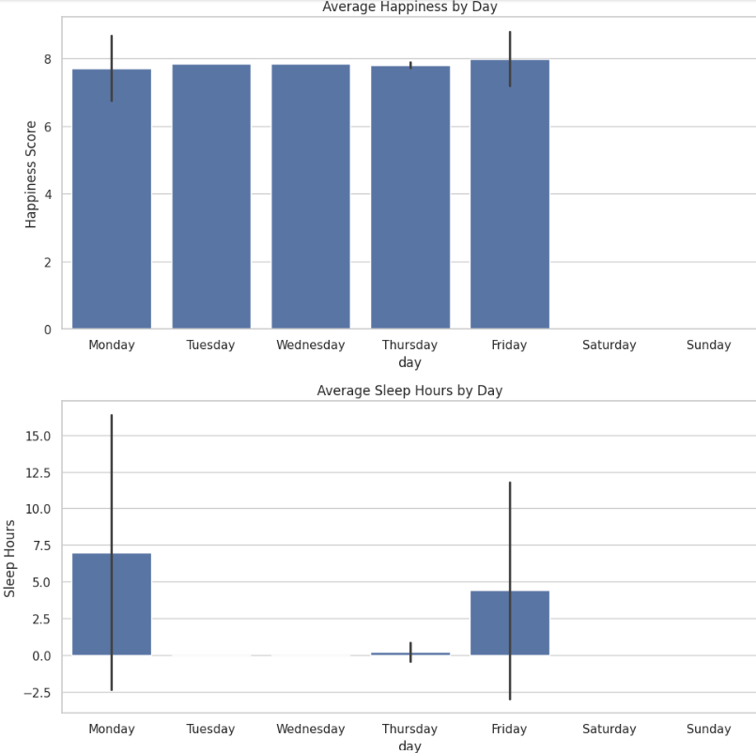
Average Happines by Day
AND
Average Sleep Hours By Day

Slide 13
Conclusion
Sleep and morning routines tend to improve mood.
Electronics use often correlates with lower happiness.
Most students share common happiness patterns.
Data science reveals powerful insights into everyday behavior.

Slide 14
Contribution Statement
Bhupathi Vishwanath : Handled data extraction, cleaning, and activity normalization.
Joana Dervishaj : Developed hypotheses and performed data analysis.
Vinayak Vemula : Created visualizations and prepared the final presentation.

Slide 15
